Slide 1

Assignment 1: Understanding Visualisation Techniques
Presenter: Maninderpreet Singh Puri
Student ID: 20494381
Video URL: https://web.microsoftstream.com/video/87f32721-5309-4d5a-9695-1bd9201061db

Slide 2
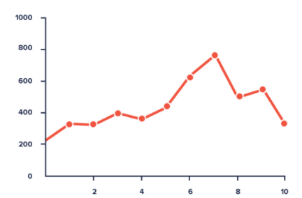
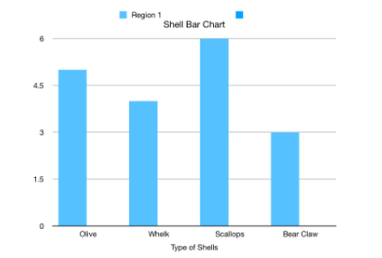
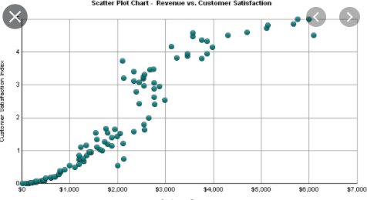
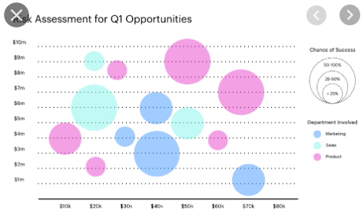
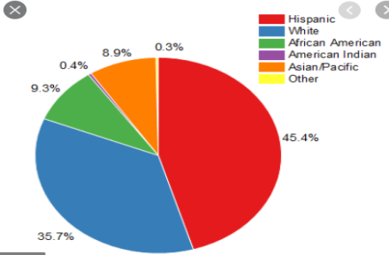
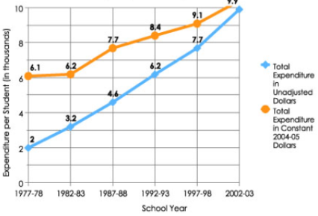
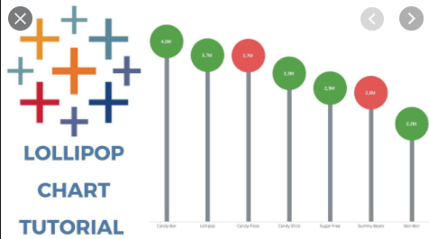
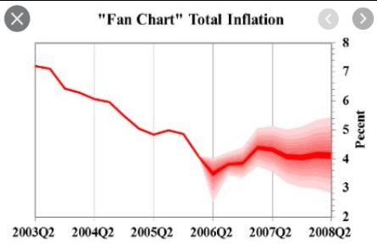
Data Visualization
Purpose: The intent of visualization is to represent a set of data in a clear and meaningful way. Adding beautiful visuals by colors shapes and sometimes symbols to make it attractive and interesting while gaining insights.
Conventional Visualizations: Bar chars, graphs, line charts, pie charts.
Novel visualizations: Scattered plots, bubble charts, Lollipop charts, Fan chart.

Slide 3
Case Study 1

Slide 4
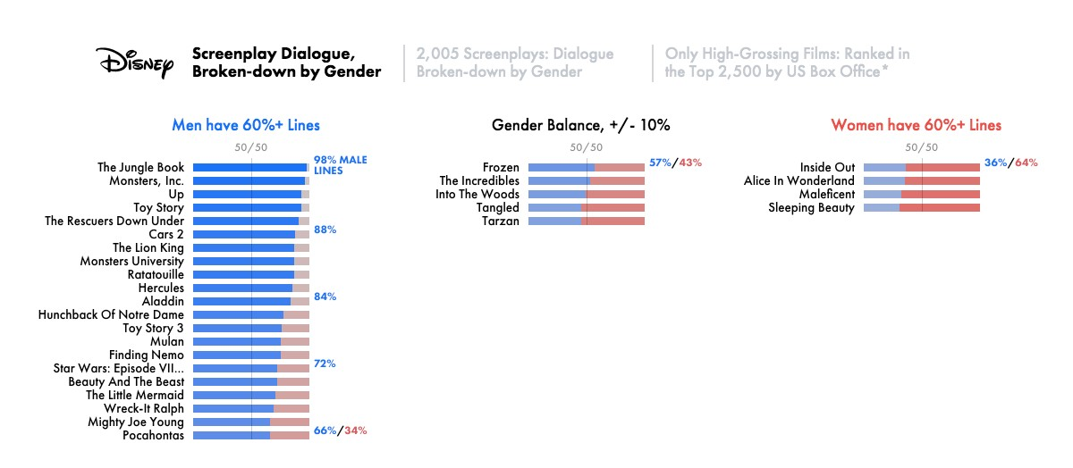
Case study 1

Slide 5
Case study 1
First case study is about a Nominal data type- Top Disney movies with screenplay dialogues broken down by gender. It is a good visualization as it elucidates the gender disparity of movies by:
Using colours (blue for men and red for women) for highlighting the key categories.
It uses the right type of graph that is spine chart to show at a glance how one gender compares with others across a range of movies. It forms a central line or 'spine' on the chart to show how close are the proportion of males and females dialogues to the middle (50%).
It uses titles and subtitles to convey the main points in all three charts.
The subtitles add post-processing.
It annotates and displays a range of intervals describing which gender has more screenplay dialogues.
It is an excellent example of good visualization as it clear and informative. It also explains the goal clearly by defining a suitable heading, avoiding adding irrelevant information. It draws the attention by highlighting the keys features and user can get the ‘gist in a look’.

Slide 6
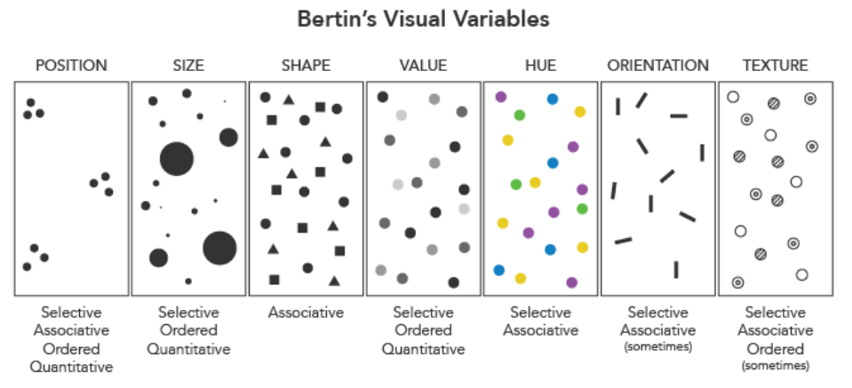
Case study 1
We can relate this to lecture notes where we learned about selective variables stated by Bertin. Homogenous group can be described by same colors. In the example bight colours blue and red are perfectly chosen for categories males and females.

Slide 7
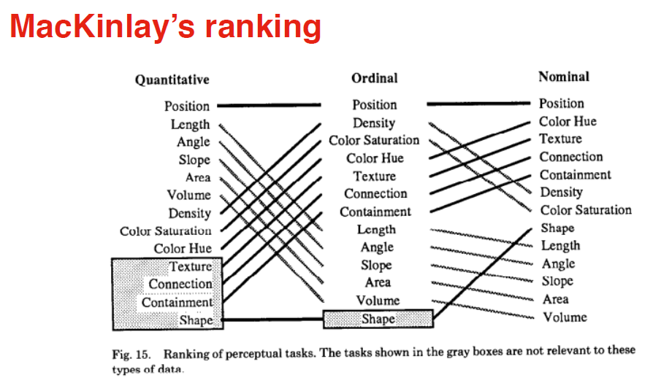
Case study 1
We can also see that it matches the Mackinlay’s ranking for presenting nominal data.

Slide 8
Case Study 2

Slide 9
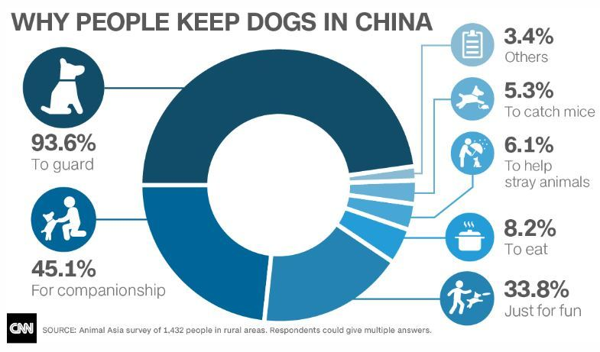
Case study 2

Slide 10
Case study 2
Second case study is about a Nominal data type-.Why people keep dogs in China. It is a good visualization however it has some problems:
The total percentage of the given categories is 195.5% which is incorrect percentage to show the proportions.
Center of the donut chart should be utilized to present the addition stats of the graph.
No post-processing used to get new information.
Also if the categories are too close it is hard to interpret the differences.
Although it uses visualization features such as colors (Dark blue to light blue), size of bubble, annotations, titles but lacks novel information from what is already presented. It draws the attention by highlighting the keys features and but doesn’t give new insights into the data for user to gain interest.

Slide 11
Case study 2

Slide 12
Case study 2
After normalizing data between 0-100

Slide 13
Conclusion
Visualizations are very important part of data science and is the final step of the whole data management process.
Presenting data in a clear, efficient and meaningful way is the best version of data visualization.
Data visualizations depend on the type of data weather Nominal, Ordinal, Interval.
Using color, shapes, annotations to highlight.
Using annotations to bring clarity.
Interactive user interface like data flow in a time series(in motion).
Faceting.
Post processing.

Slide 14
References
(WTF Visualizations)
(Univeristy, 2020)

